Slide 1




Insurance Analytics
PRESENTED BY GROUP 2
Pokala Deepika
N Tanuja
Gude Yuvateja
Pranam S
Soham Arote

Slide 2
AGENDA
Project Overview
KPI Analysis
Dashboard Design
Dataset Description
Recommendation
Closure
Conclusion

Slide 3
Project Overview
Branch dashboard to discuss New and renewal business number with each branch. This dashboard will be discussed between Corporate team and Individual branch heads.
Discuss performance metrics in the branch.
Overall performance summary
Detailed branch performance
Key insights and action items
Summary of new, cross sell and renewal business numbers for the branch

Slide 4

Dataset Description
Brokerage -> Contain information about clients' policies, including policy details, income, and renewal status
Fees -> Contains data on client-related income transactions, including revenue details and transaction types.
Budget -> Details the budget allocations for branches and employees, including new roles, cross-sell initiatives, and renewals.
Invoice -> Holds information about invoices generated, including transaction details and associated clients.
Meeting -> Tracks meetings managed by account executives, including branch associations and attendee details.
Opportunity -> Documents details of opportunities managed by account executives, including revenue, stages, and risk information.

Slide 5
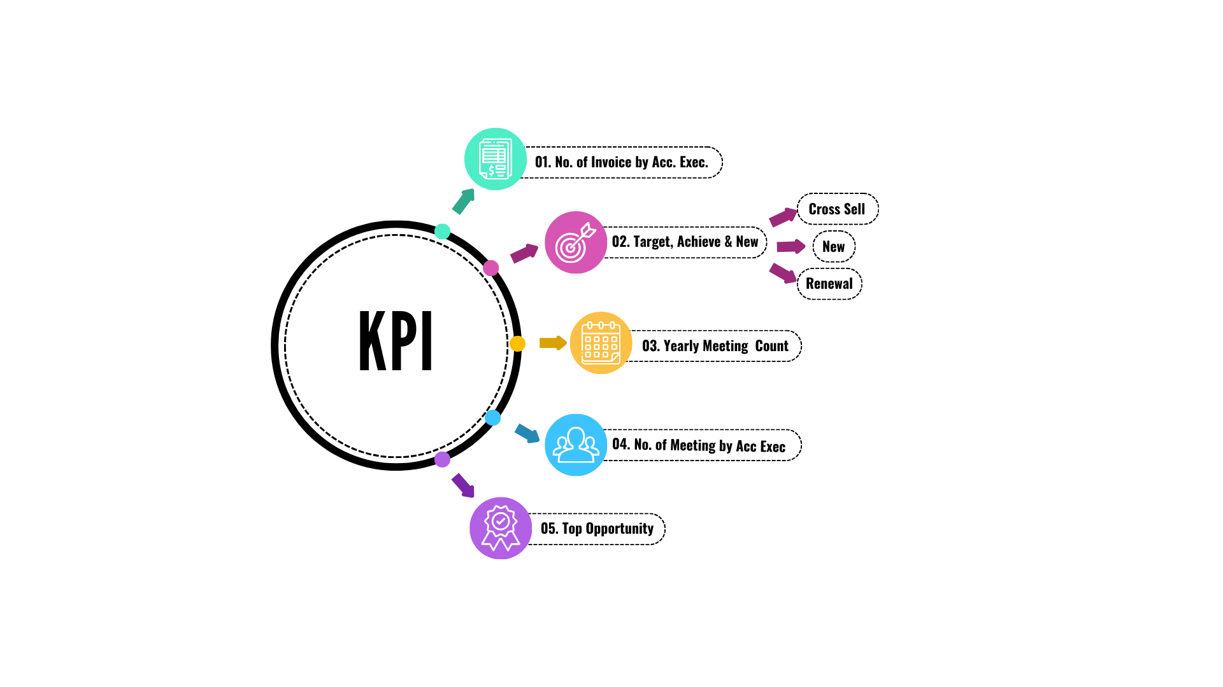

Slide 6
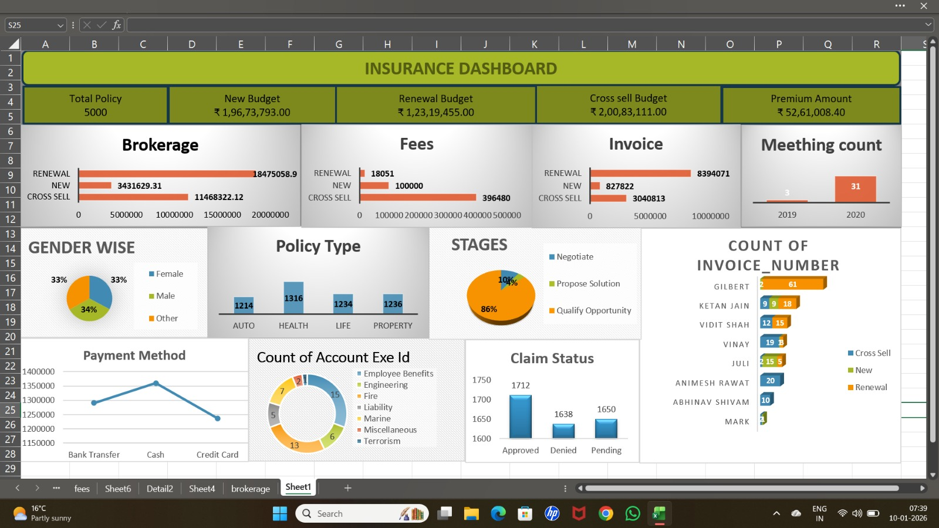
Excel Dashboard

Slide 7
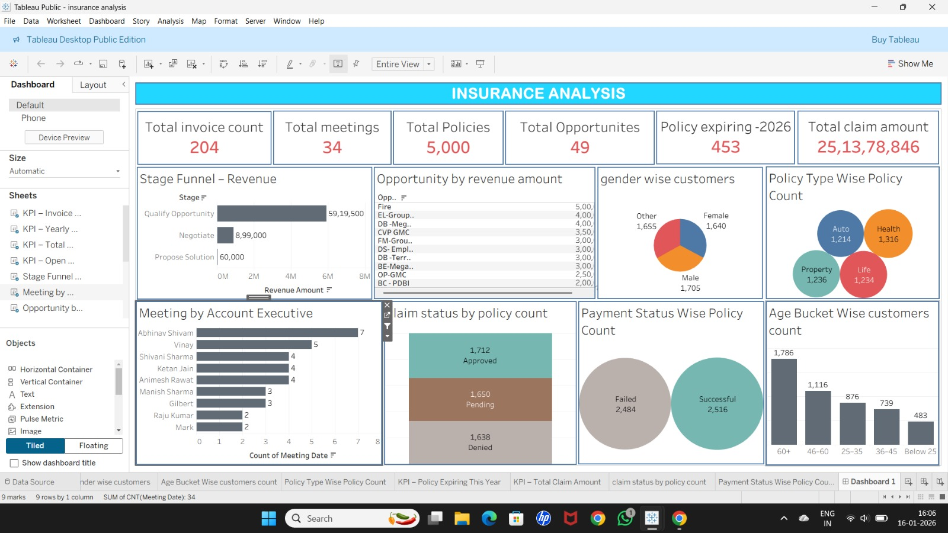
Tableau Dashboard

Slide 8
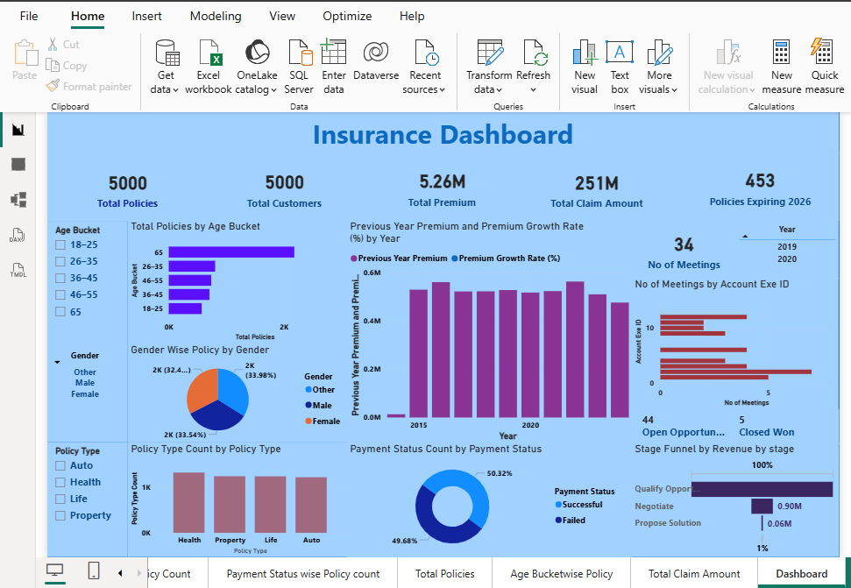
Power BI Dashboard

Slide 9
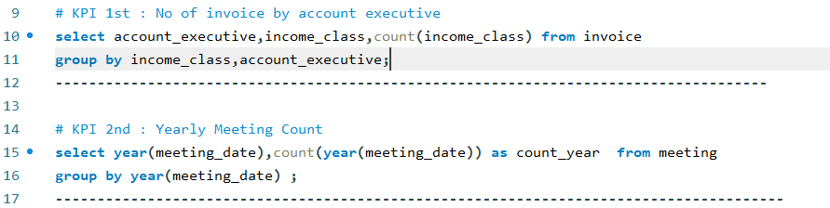
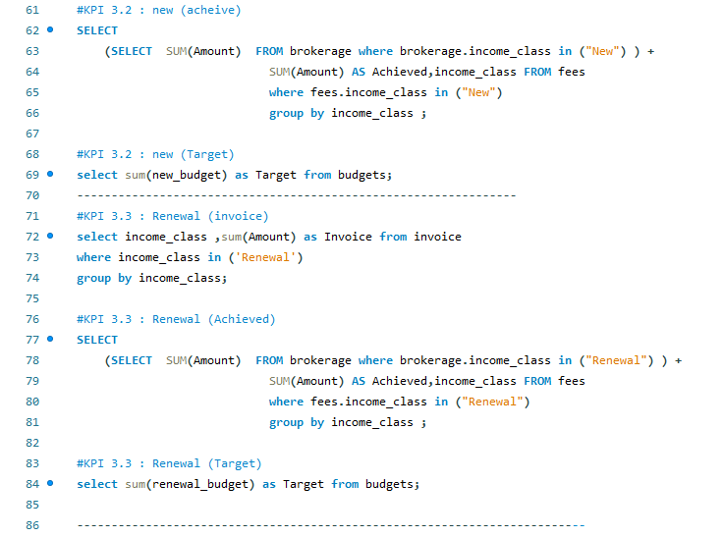
My SQL Queries

Slide 10
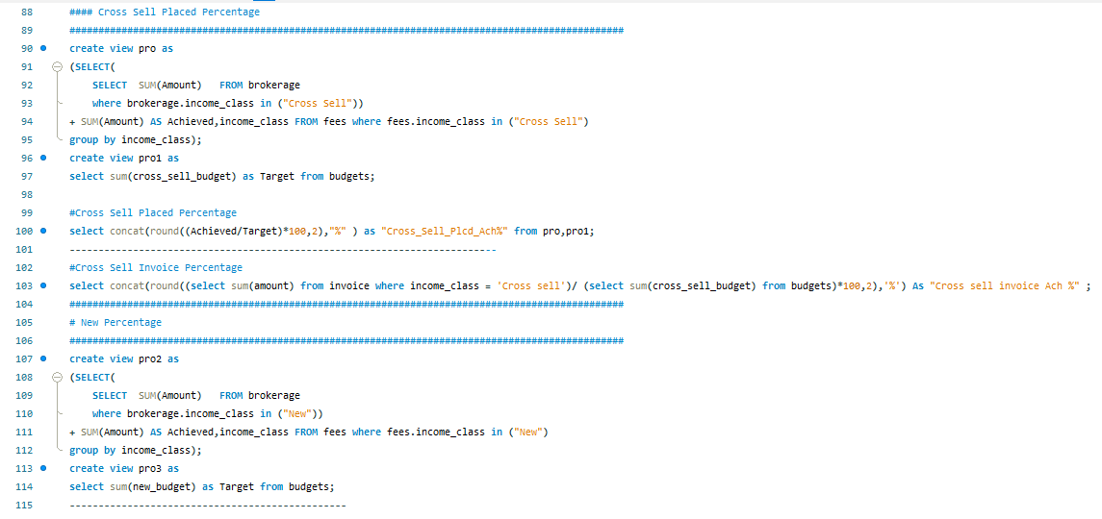
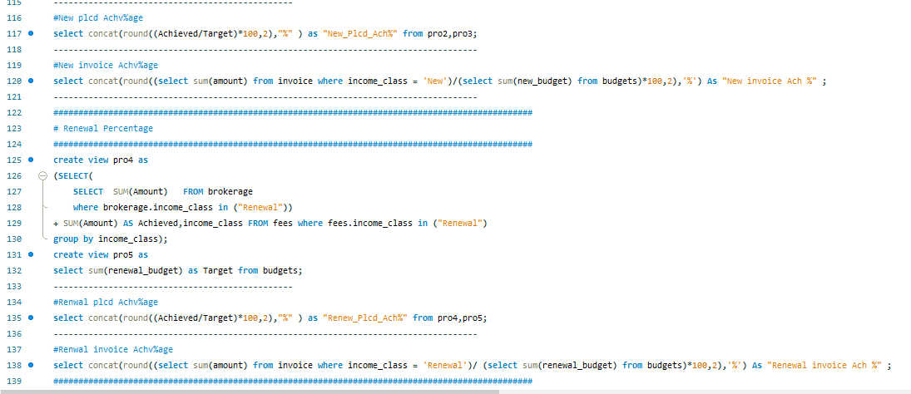
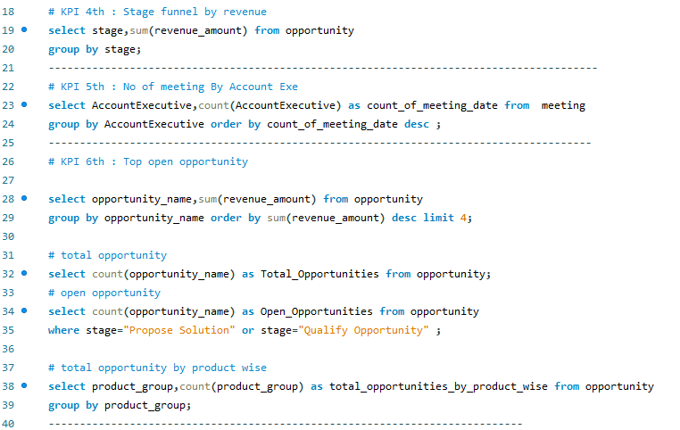

Slide 11
Conclusion
New Policies
Steady growth with a decent profit margin. Need to focus on increasing the growth rate.
Total: 19.674 M
Profit: 0.5698 M
Revenue: 3.5316 M
Profit Margin: 17.95%
Growth Rate: 2.90%
Cross-Sell Policies
High profitability and significant growth. Continue leveraging cross-selling opportunities.
Total: 20.083 M
Profit: 2.854 M
Revenue: 13.04 M
Profit Margin: 64.94%
Growth Rate: 14.21%
Renewal Policies
Exceptional performance in renewals with very high profitability and growth. Maintain this strong focus
Total: 12.32 M
Profit: 8.244 M
Revenue: 18.507 M
Profit Margin: 150.23%
Growth Rate: 66.92%

Slide 12
Recommendation
Enhance Customer Service
Implement AI-driven chatbots for 24/7 customer support.
Train staff on customer engagement and conflict resolution.
Expand Product Offerings
Introduce new insurance products tailored to emerging markets.
Bundle products for better value to customers.
Increase Sales and Retention
Launch personalized marketing campaigns based on customer data.
Introduce loyalty programs to reward long-term customers.
Market Analysis and Adaptation
Conduct market research to identify customer needs and preferences.
Adjust strategies based on competitive analysis and market trends.
Employee Engagement
Foster a positive work environment to boost employee morale.
Introduce employee recognition programs to retain top talent.
Enhance Operational Efficiency
Conduct regular training sessions for employees on new technologies.
Team collaboration activities

Slide 13
Thank you!

